Slide 1
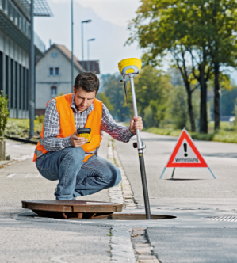
Zenith35/ Pro «TAG SINGLE MODE»

Slide 2
Contents
Required Equipment
TAG Single Mode – what is it?
TAG Single Mode – Typical accuracy
Compass Calibration
Examples & Recommendations

Slide 3
Required Equipment
Zenith35 TAG or Zenith35 Pro TAG
Latest onboard firmware version installed
Zenith35 TAG ≥ V 1.25
Zenith35 Pro TAG ≥ V 2.01
Compass Calibration Tool
Latest Field Software version installed
X-PAD ≥ V 3
GeoMax FieldGenius ≥ V 9
Field Controller
GNSS Pole

Slide 4
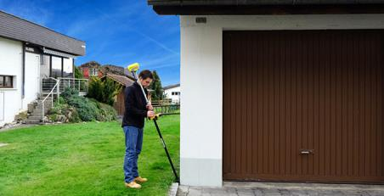
What is the «TAG-Single»
Zenith35 TAG includes tilt sensors for pole tilt calculation and e-compass to detremine the North direction
All Zenith35/Pro TAG includes tilt sensors and compass
Until now Zenith35 TAG was available only with «TAG-Dual mode»
Hidden points was measured with two measures with pole was tilted

Slide 5
What is the «TAG-Single»
The last firmware enables the electronic compass installed within the Zenith35/ Pro TAG
The new firmware enables the e-compass to estimate the North direction
This allows you to measure points without holding the pole levelled and vertical
Only one measure is needed to record points with the pole tilted

Slide 6
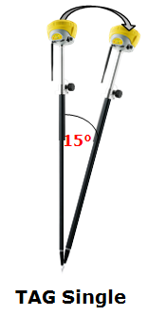
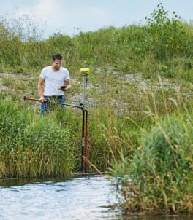
What is the «TAG-Single»
1 point measurements → to increase efficiency
Suitable for survey and stakeout operations!
Tilt range: 15°
→ equals to 52cm deflection @2m pole height

Slide 7
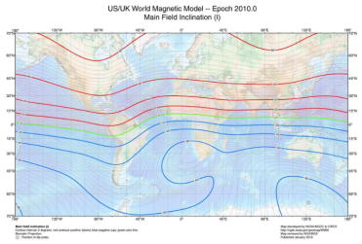
What is the «TAG-Single»
The Tilt Sensor is used to determine the degree of inclination. This is measured with accelerometers
The Compass is used to determine the direction of tilt. This is measured by magnetometers
➔ Since the compass principle is based on the earth magnetic field, measuring with the compass close to metal objects with an own magnetic field or objects generating magnetic fields such as generators is error-prone.

Slide 8
Accuracy
Accuracy (typical)*
 | 2D- Position** | 1D-Position (Height)
5°-Tilt | ~ ±1 cm | ~ ±1 cm
10°-Tilt | ~ ±2 cm | ~ ±1.2 cm
15°-Tilt | ~ ±3 cm | ~ ±1.5 cm
* The following values represent an average achieved during tests under normal to favourable conditions.
** Please note that these error needs to be applied on top of the standard GNSS accuracy.

Slide 9
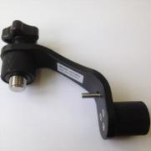
Compass calibration
Before starting to use the compass it is needed to perform a calibration routine
The calibration rountine has 3 main steps:
Calibrate the e-bubble
Scanning modelling the local magnetic field
Controlling if the calculated model fist
A calibration tool is needed to perform the calibration
Included in new Zenith35 Pro TAG packages or as an optional accessory for Zenith35 TAG

Slide 10
Compass calibration – Local conditions
The compass is sensible to magnetic fields, such as
Local earth’s magnetic field
Cars
Powerlines
Generators
Steel reinforced buildings
Choose a location where the possible interferences are minimum
Calibration of the compass is required to “fit” the local earth’s magnetic field, conditions, surroundings and environment. The calibration must be done before starting the measurement campaign

Slide 11
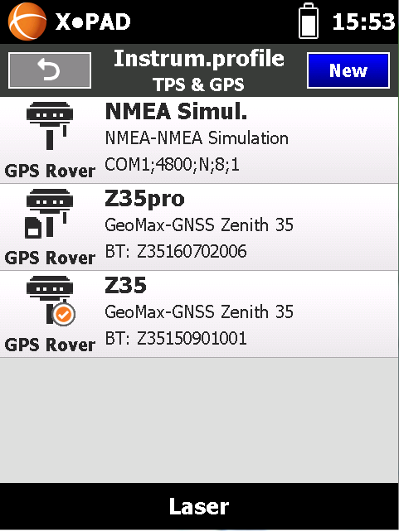
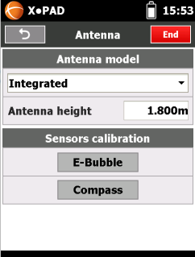
Compass calibration – X-PAD
To start the calibration routine open the X-PAD instrument settings
Create a new profile or modify an existing profile
In the Antenna page click on Compass to start the calibration routine

Slide 12
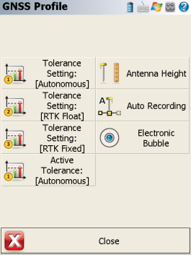
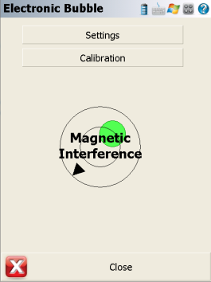
Compass calibration – FieldGenius
To start the calibration routine after the Zenith35/ Pro is configured and connected open Instrument Settings and Sensor Configure
Click on Electronic Bubble
Click on Calibration to start the calibration routine

Slide 13
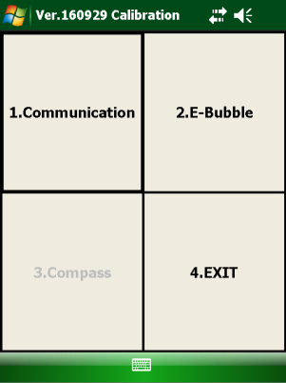
Compass calibration
To calibration is done in different steps
IMPORTANT: The receiver must be fixed while doing the calibration routine!

Slide 14
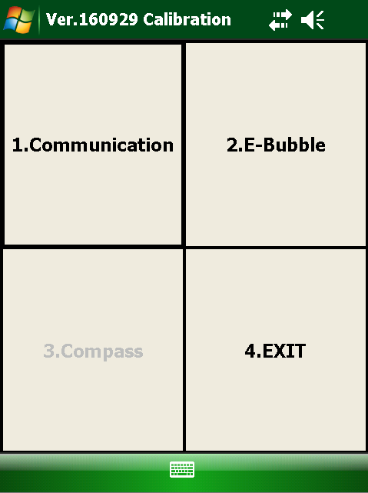
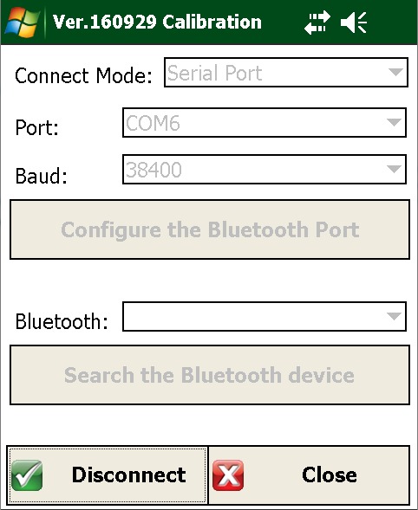
Compass calibration
Click on Communication to verify that the Zenith35/Pro TAG is connected by Bluetooth

Slide 15
Compass calibration
Click on E-bubble to start to calibrate the electronic bubble
You must stay vertical with the pole and press START

Slide 16
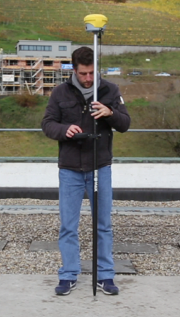
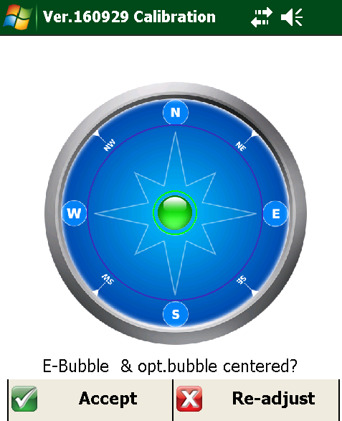
Compass calibration
Check that the result is correct
Press Accept to validate the result

Slide 17
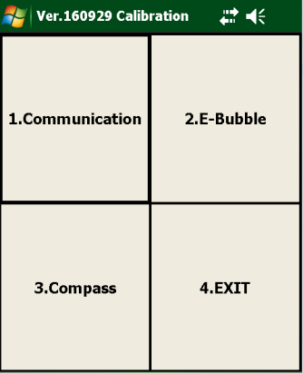
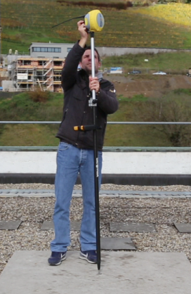
Compass calibration
Click on Compass to open the next step
Mount the calibration tool on the pole

Slide 18
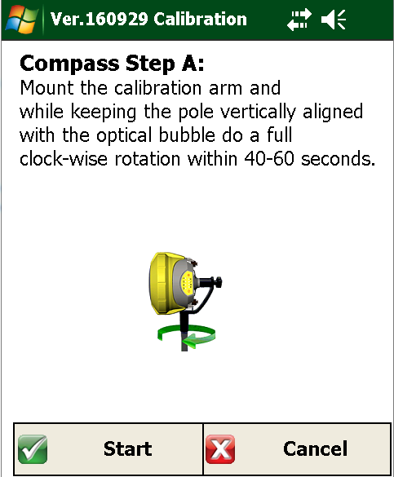
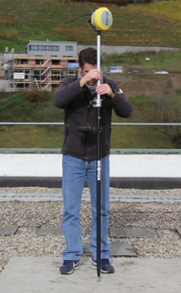
Compass calibration
Click Start and slowly rotate clockwise the pole, while vertical
The full rotation should take about 40-60 seconds

Slide 19
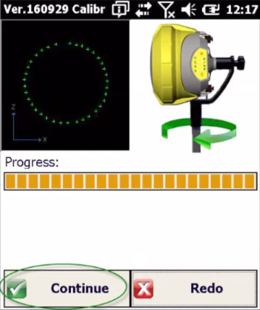
Compass calibration
If the calibration is well done you see a circle. After the progress bar is completed, click Continue
If on the left side you don’t see a circle, but the points are random, it is recommended to change the calibration area

Slide 20
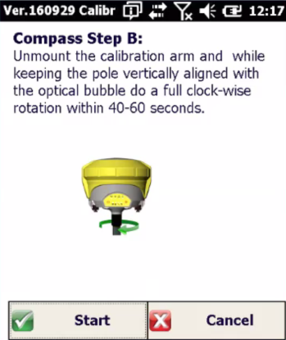
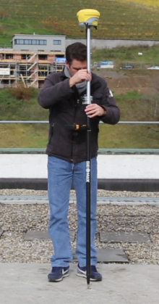
Compass calibration
Unmount the calibration tool and place the pole vertical
As before rotate clockwise the pole within 40-60 seconds

Slide 21
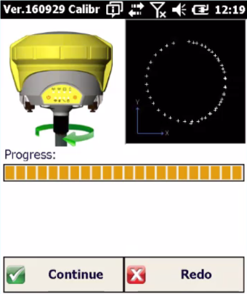
Compass calibration
If the calibration is well done you see a circle. After the progress bar is completed, click Continue

Slide 22
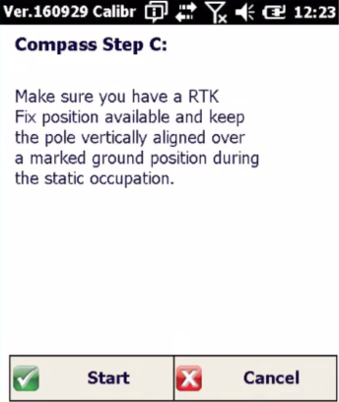
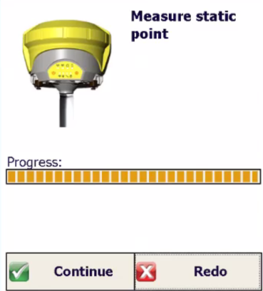
Compass calibration
For the next step verify that the receiver is FIXED
Occupy a marked ground position and click Start to measure the point. When done press Continue.

Slide 23
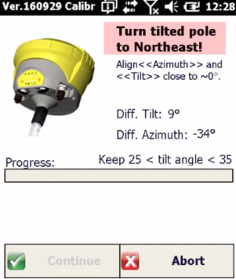
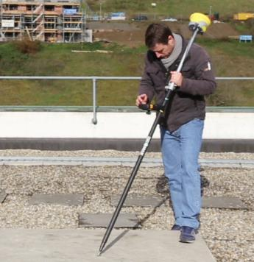
Compass calibration
While on the same marker, you must measure 4 points with the pole tilted and oriented on different Azimuth angles
You must tilt the pole until the Diff.Tilt value is close to zero and rotate around the point until the Diff Azimuth is close to zero

Slide 24
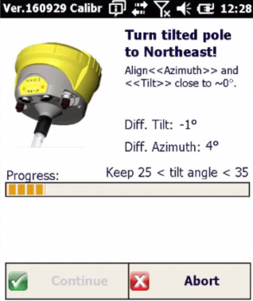
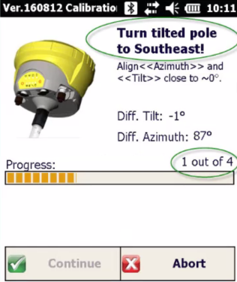
Compass calibration
While the two angles are close to zero the instrument measures the point
Wait few seconds until point is saved. Then rotate to next angle

Slide 25
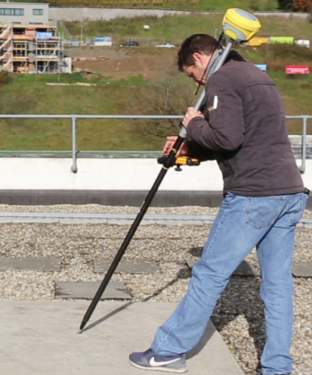
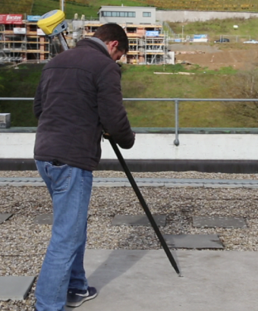
Compass calibration
Proceed in the same way for all the four points
When done press Continue to complete the calibration

Slide 26
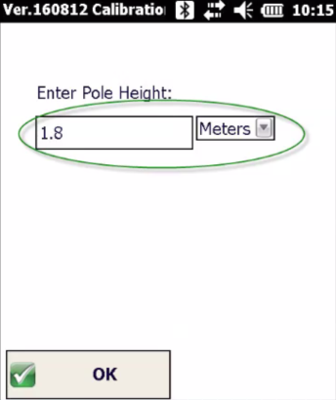
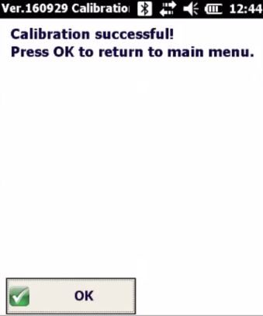
Compass calibration
Enter the pole height
Check that the calibration is succesful!

Slide 27
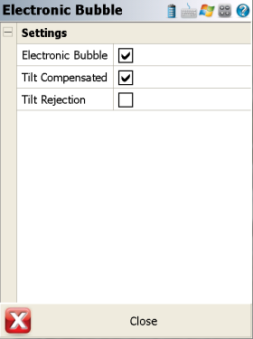
Compass calibration
Calibration is done and now you can start to use the compass to measure all points with pole tilted!
GeoMax FieldGenius
Enable it from Electronic Bubble menu

Slide 28
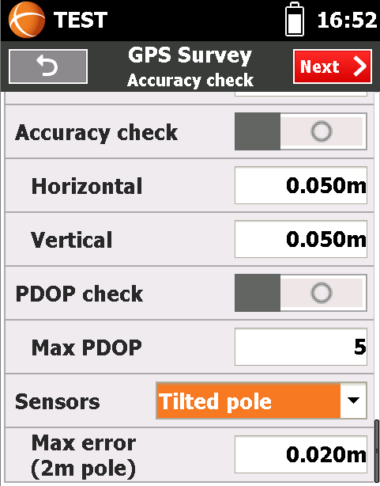
Compass calibration
X-PAD
Enable it from Survey Settings

Slide 29
When re-calibrate?
A re-calibration is needed after:
A change of location
A significant drop
A significant temperature change (30° or more)
A long period without calibration
A transport (-> vibration)
A battery is inserted that was never inseted before
A firmware upgrade
➔ Not calibrating the unit after events as listed above negatively affects the accuracy of the measured points.

Slide 30
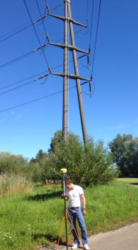
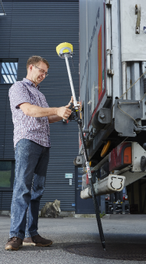
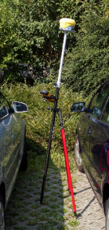
Examples and Recommendations
Bad measurement conditions - Following examples showing locations with high magnetic influence, resulting in a point accuracy about 5-10 times worse as typical. Typical situations are measurement close to cars, lamp poles, and power lines. Errors of 30-50 cm appeared during our tests….
➔ In those cases it is mandatory either to switch off the Single mode at all and measure in conventional way, holding the pole vertical or if not possible, to use the dual mode to eliminate the magnetic influence.

Slide 31
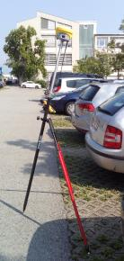
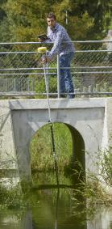
Examples and Recommendations
Medium measurement conditions - Following examples showing locations with some magnetic influence, resulting in point accuracy worse as typical. Typical situations are measurement on car-parking lots, house corners, close to metal fences….
➔ In such conditions, it is strongly recommended to perform a control measurement to see if the achieved accuracy is sufficient.

Slide 32
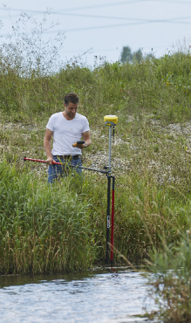
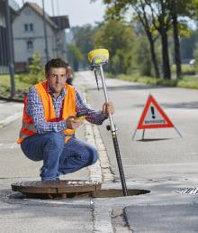
Examples and Recommendations
Good measurement conditions - Following examples showing locations with low to none magnetic influence, where you can expect the above listed typical point accuracy.

Slide 33
Thanks for your attention
Any question?
For comment/suggestion please send an email to:
support@geomax-positioning.com

